Slide 1
NASA Teacher Leadership Triad 2012
Julie Archer
Erin Binns
Jessica Cimino
Deb Ramm

Slide 2
Big Idea 4: Earth is Continually Changing
Key Concepts:
Earth is continually changing.
The dynamic of Earth’s surface is a direct result of these changes.
Key Teaching Skills:
Assessing student prior
Classroom management
Manage cooperative groups

Slide 3
Think Pair Share
Purpose:
Getting participants to become aware of the Nine Big Ideas of Earth Science Literacy and previewing the day’s content matter
Ask teachers to independently come up with the two big ideas in Earth Science everyone should know. Have them then share with the group and have the group come up with a consensus answer to share with the group. These should be written on sentence strips or chart paper and posted around the room. Compare to the Nine Big Ideas of the Earth Science Literacy Principles

Slide 4
Brain Maps and Modeling
Purpose:
Assess the level of participants prior knowledge on ways the Earth is constantly changing.
Have participants create thinking maps/brain maps (using various colors to connect concepts) with Geologic Processes as the key word. All ideas should be shared and posted on the wall to share as the whole group.

Slide 5
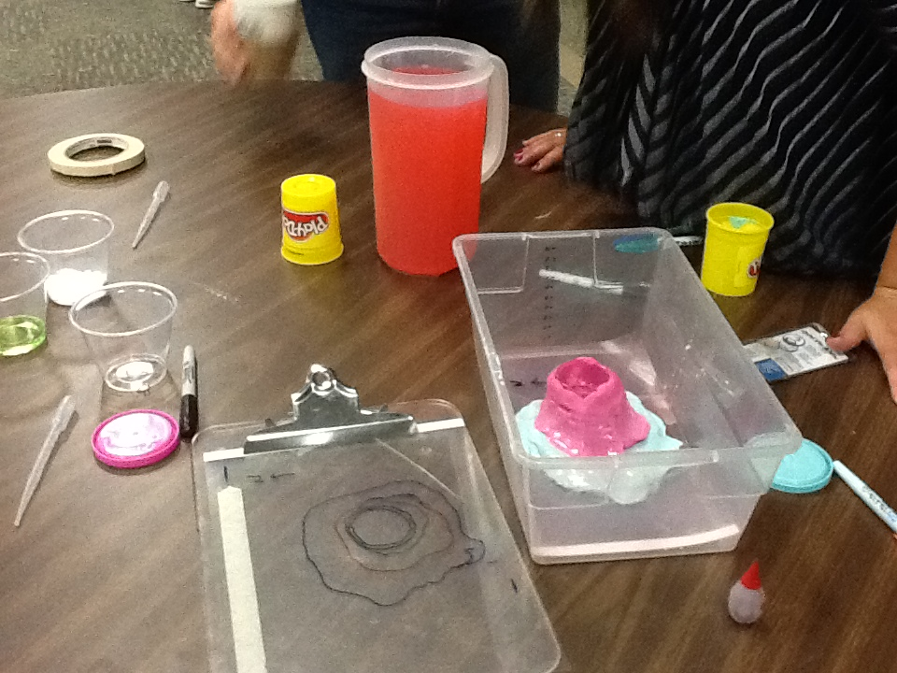
Lesson 1: Lava Layering
Essential Question: “What are the forces that cause Earth to continually change?”
This serves as the purpose statement for the day’s activities. At this point two activities will be conducted in groups to explain the outcome of geologic events such as volcanoes.

Slide 6
Lesson 2: Predict the Flow
Essential Question: How can you use a volcanoes topography to predict which way lava will flow down its slopes?
Students will use the model they prepared in an inquiry based lesson to determine the flow of lava.

Slide 7
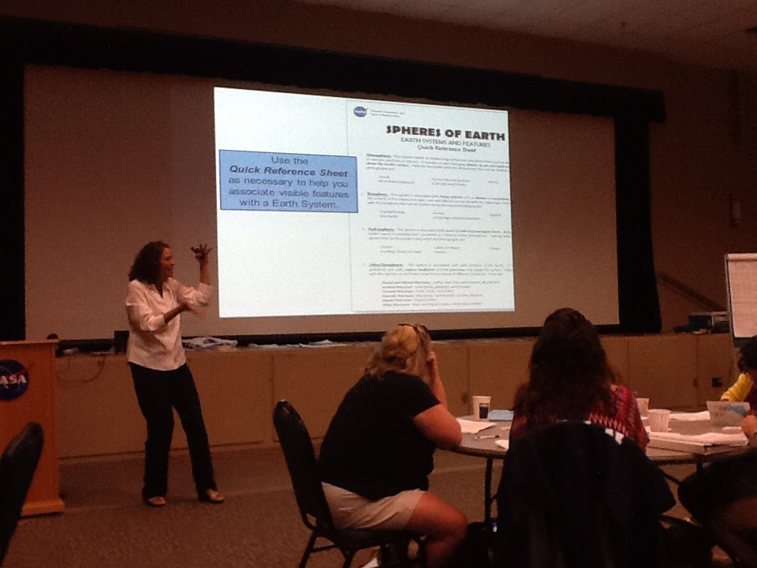
Lesson 3: NASA Spheres of Earth
Essential Question: How does the Earth’s Spheres work as a system?
Students will use pictures, technology and prior knowledge to identify earth’s features and geomorphology.

Slide 8
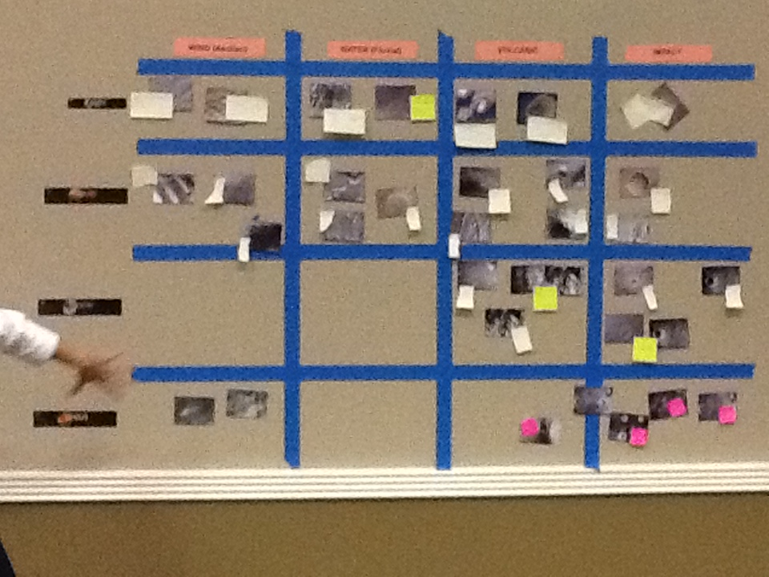
Lesson 4: NASA Blue Marble Matches
Essential Question: How do scientists determine what geologic features exist on other planets?
Students will use their knowledge of earth’s geology to identify inter-planetary geologic features using technology and other satellite images.

Slide 9
Closing
Big Idea 4 video, revisit pre-assessment, give evaluation, and provide NASA resources.
http://youtu.be/QBApevfNkkA
NASA/Earth Expeditions
Earth Spheres and
Blue Marble Lessons
AGI
Lava Flows and Predictions Lessons

